Slide 1

What is Red?
ReCode 2013, Montréal
Nenad "DocKimbel" Rakocevic

Slide 2
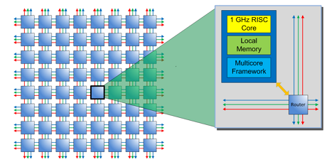

Why Red?
Our computing world is going through deep changes…
"Massively parallel 64 core computer costs $99" -Parallela
We are moving away from traditional computers.

Slide 3
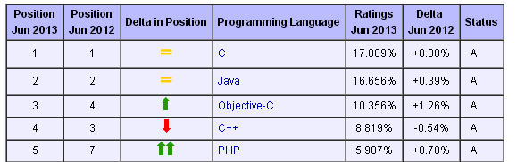
Why Red?
…yet we are using rusty software solutions.
Year of Birth
1972
1995
1983
1983
1995

Slide 4
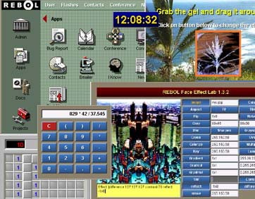

Why Red?
Rebol was partially answering those concerns…

Slide 5
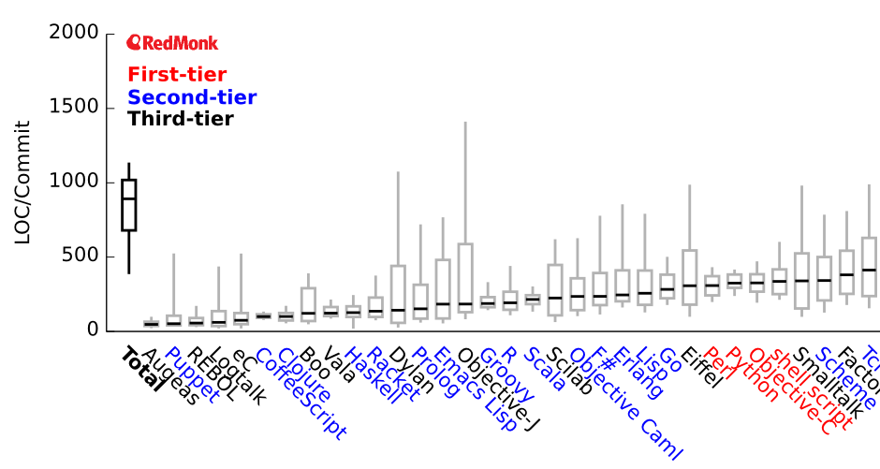
Why Red?
…doing wonders, only recently acknowledged,…
Programming languages ranked by expressiveness

Slide 6
Why Red?
…but Red will go far beyond!

Slide 7
What is Red?
A "full stack" programming language
  True general-purpose programming solution
  A stand-alone toolchain
A tool for empowering users
  Simple to use
  Unlimited usage, no arbitrary restrictions
  Feeling "in control" again
Red is bringing back the fun to programming!

Slide 8
Natural scope of application
Abstraction level
Rascal
Red
Meta DSL
Ruby
REBOL
DSL
Python
Javascript
Scripting
C
Pascal
Java
C++
Applications
OS
ASM
Red/System
Drivers
Hardware

Slide 9
A standalone toolchain 1/5
Embedded
Desktop
Android devices
Windows
Linux
iOS devices
MacOS X
Raspberry Pi
Red
Syllable
FreeBSD
Arduino boards
(AVR 8/32-bit)
.NET
Javascript
JVM
Virtual Machines

Slide 10
A standalone toolchain 2/5
Compile script and run it from memory
  $ red script.red
Compile script and output an executable
  $ red –o script script.red
Cross-compile script and output an executable
  $ red –t Windows –o script script.red
Compile a Red/System script and output an executable
  $ red script.reds
Compile script as shared library
  $ red –dlib script.red
Launch Red in REPL mode
  $ red
  Currently: >> do/args %red.r "-dlib script.red"

Slide 11
A standalone toolchain 3/5
Cross-compilation made right!
$ red –t <TargetID> script.red
Target ID | Target Description
MSDOS | Windows, x86, console-only applications
Windows | Windows, x86, native applications
Linux | GNU/Linux, x86
Linux-ARM | GNU/Linux, ARMv5
Darwin | Mac OS X Intel, console-only applications
Syllable | Syllable OS, x86
Android | Android, ARMv5
Android-x86 | Android, x86
RPi | Raspberry Pi, ARMv5

Slide 12
A standalone toolchain 4/5
Red toolchain
x86, ARMv5+,
ARMv7, Thumb, x86-64,…
Compiler
x86, ARMv5+,
ARMv7, Thumb, x86-64,…
JS, JVM bytecode, Dex, MSIL,…
Linker
PE, ELF, Mach-o, Intel-HEX
Executable, Shared library
Static library, kernel driver,…
Packager
Android - APK
iOS - IPA
Webapps – WAR
...

Slide 13
A standalone toolchain 5/5
2011-2013
2014
Bootstrapped
Self-hosted
in Rebol 2
in Red
JIT-Compiler
Last dependency to remove for full feature access!

Slide 14
Red language 1/4
Syntax and semantics very close to Rebol
  Definitional scoping
  Dynamic binding
Paradigm-neutral
  Imperative, OOP, functional, symbolic,…
Optionally typed arguments and locals
  From pure interpretation to very specialized compilation
  Type inference by default, when possible

Slide 15
Red language 2/4
Unicode support
  Input sources in UTF-8, external codec for other encodings
  Auto-adaptative internal representation: UCS-1, UCS-2 or UCS-4
Concurrency support
  Task parallelism: light threads over multiple cores with Actors.
  Data parallelism: SIMD and multi-cores processing using parallel series.
Meta-DSL abilities
  DSL-maker dialect (higher-level than PARSE)

Slide 16
Red language 3/4
Compiles to Red/System code
Red input
Red stack
Red/System output
stack/mark-native ~set
word/push ~a
stack/mark-native ~add
integer/push 1
word/get ~b
actions/add*
stack/unwind
word/set
stack/unwind
'b
a: 1 + b
1
ADD
'a
SET

Slide 17
Red language 4/4
Compiled, interpreted, JIT-compiled
AOT-compiler
Compiled code
Compile-time
Run-time
JIT-compiler
Interpreter

Slide 18
Red code example
Red [title: "Hello"]
print "Hello World!"
inc: func [n [integer!]][n + 1]
foo: function [a [integer!] /bar return: [string!]][
z: "zero"
either integer? a [
return z
][
append "result=" mold inc a
]
]

Slide 19

Red internals
Red
Red/System
Rebol 2
Rebol 2
Red Console
Bridges
Compilers
Command-line Front-end
Java
Obj-C
.Net
Red Runtime
Red/System
Red
Boot script
Lexer
Lexer
Interpreter
JIT-compiler
Parser
Parser
Datatypes
Natives
Emitter
Emitter
Natives
Linker
Lexer
I/O
I/O
Packager
Memory Manager
Host Interface
OS API
Kernel
Incomplete
Hardware
Unimplemened

Slide 20
Red/System overview
Purely imperative, C-level language, with a Red syntax
Statically compiled, x4 slower than C (naïve compilation for now)
Namespaces support: context, with
Limited type system:
  Logic!, byte!, integer!, float!, float32!, struct!, pointer!, c-string!, function!
  Simple type inference
  Type casting supported
  Values type reflexion (variadic RTTI functions)
Compiler directives: #define, #include, #import, #syscall, #if, #either, #switch,…
Low-level CPU support (interruptions, I/O, stack, privileged mode)
Inlined ASM support

Slide 21
Red project metrics
BSD license (BSL for the runtime parts)
Source code hosted on Github since March 2011
  version 0.3.2, 9 commiters, ~2050 public commits
  496 tickets in bugtracker (95% closed)
  ~18000 unit tests (framework built by Peter WA Wood)
  390 KiB of sources for Red/System
  8500 LOC for Red/System compiler
  2600 LOC for Red/System linker
  2800 LOC for Red compiler
  800 LOC for Red interpreter
  14000 LOC for Red runtime library (~150KiB compiled on x86)

Slide 22
Red remaining tasks for 1.0, until…
Complete core parts:
  implement object!, error!, typeset!, binary!, decimal!, date!, time!, …
  add proper error handling and arguments type-checking
  implement I/O infrastructure
  implement concurrency support
  define a module system and modular compilation
Provide a minimal Red IDE
Documentation:
  Write Red reference documentation
  Write some first-steps tutorials
Prepare a new red-lang.org site for 1.0 launch

Slide 23
… the real Red!
Final compiler architecture
  Two-stage JIT-compiler, with optional AOT optimizations
  Documented public API for lexer, parser, emitter and linker
  Plugin-oriented internal architecture
  Written purely in Red (self-hosted)
  Red/System: improved and cleaned-up syntax and semantics
  Very open to contributors!
Implications for current codebase in Rebol 2
  Disposable code with limited lifetime
  Not documented, monolithic, rigid, not meant for contributions

Slide 24

Project Organisation
2 collaborators on Github
11 contributors
2 mailing-list admins
3 Facebook Red page admins
iiqux (IRCbot for reporting commits)
You?

Slide 25
Thank you for listening.
Any questions?

